Slide 1
Git – First Steps
Moritz Flüchter

Slide 2
Content
Creating a repository
Making and saving changes
Metafiles
Developing in branches
Undoing changes
Other useful commands

Slide 3
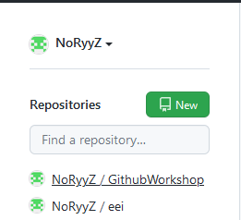
Creating a repository

Slide 4
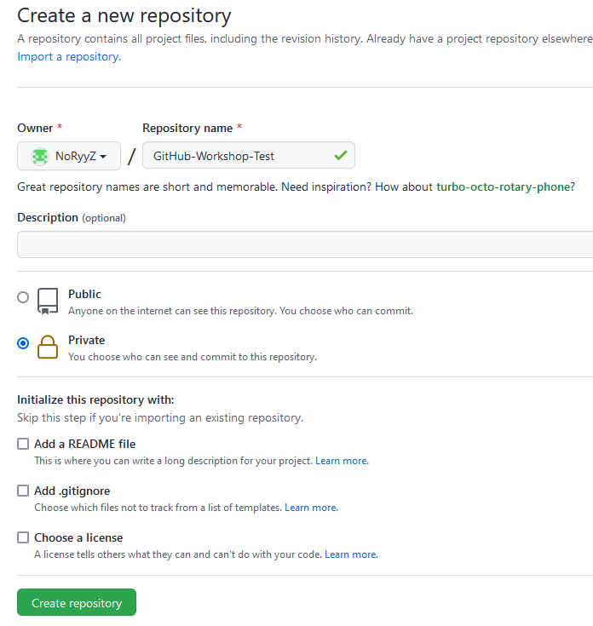
Creating a repository

Slide 5
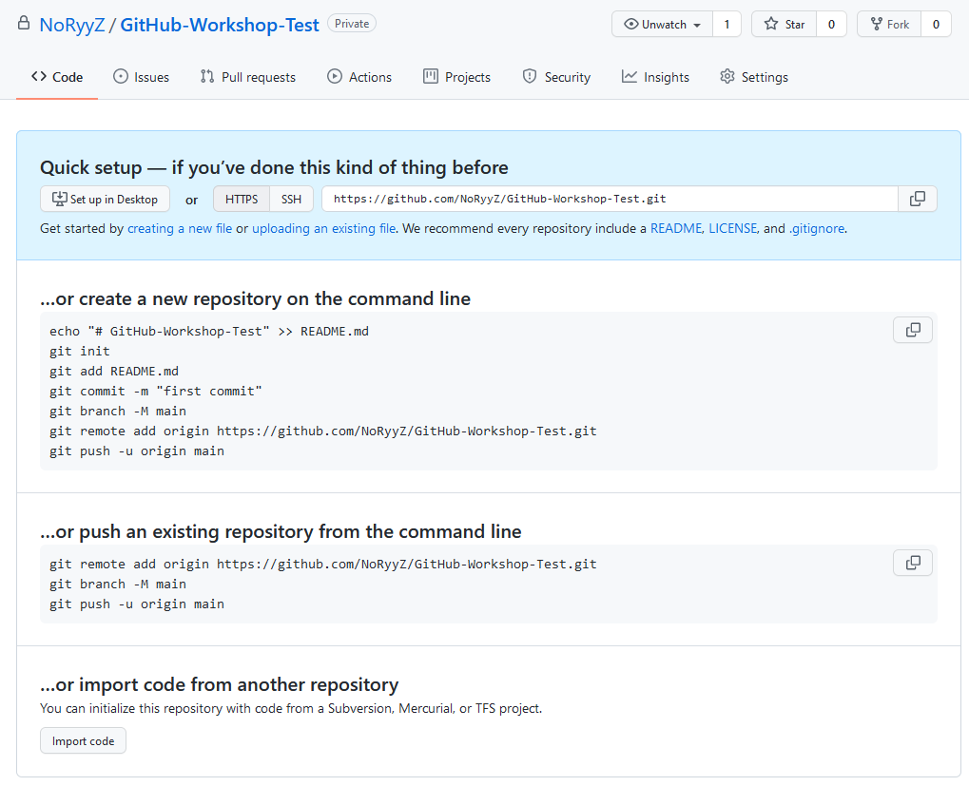
Creating a repository

Slide 6
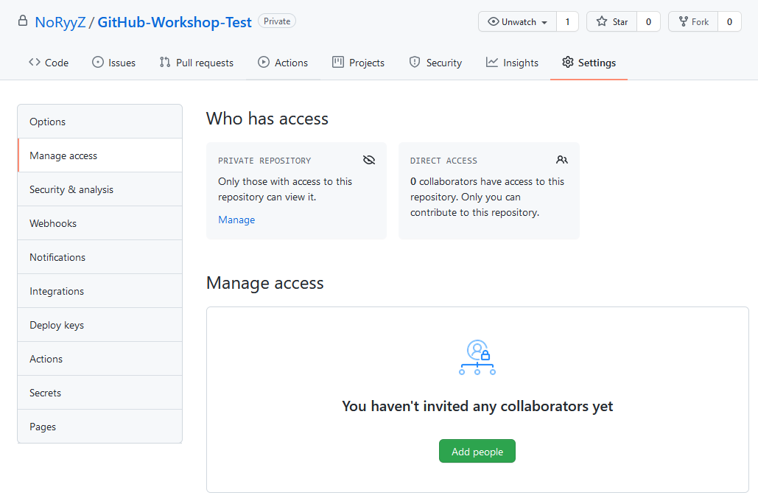
Creating a repository – Adding People

Slide 7
Content
Was Git nicht macht: automatisch nach updates checken im repository, immer erst git pullen

Slide 8
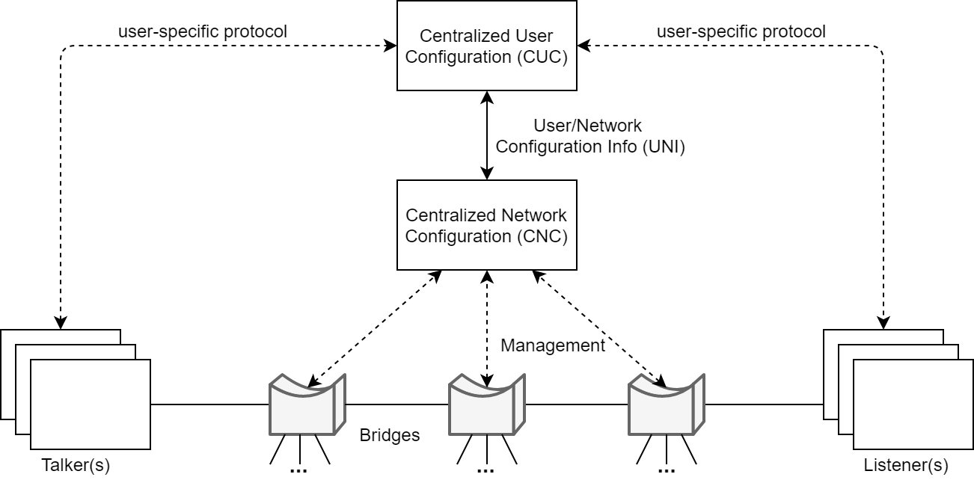
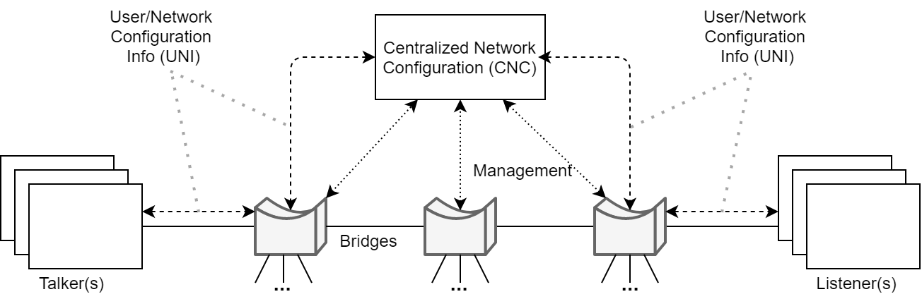
COMPARISON/2 TOPICS
HEADING 1
HEADING 2
TEXT
TEXT

Slide 9
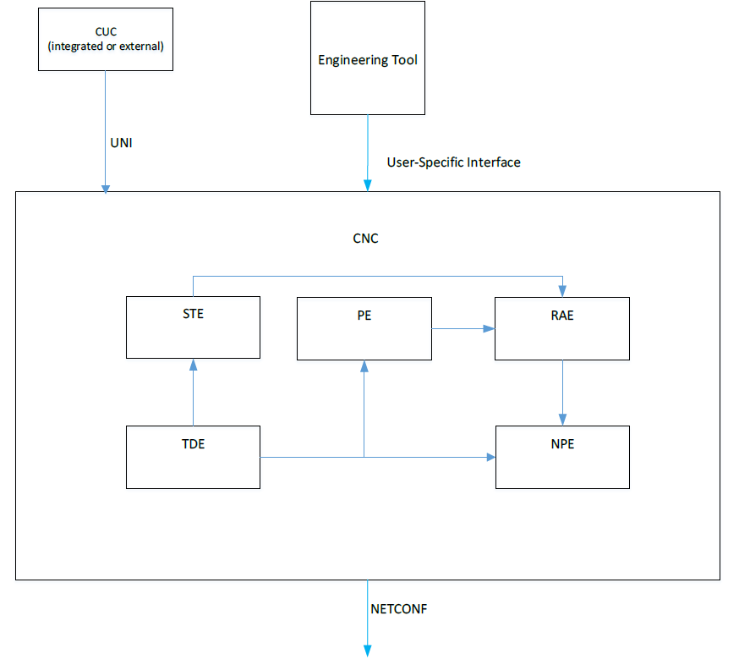
TEXT + IMAGE
HEADING
TEXT

Slide 10
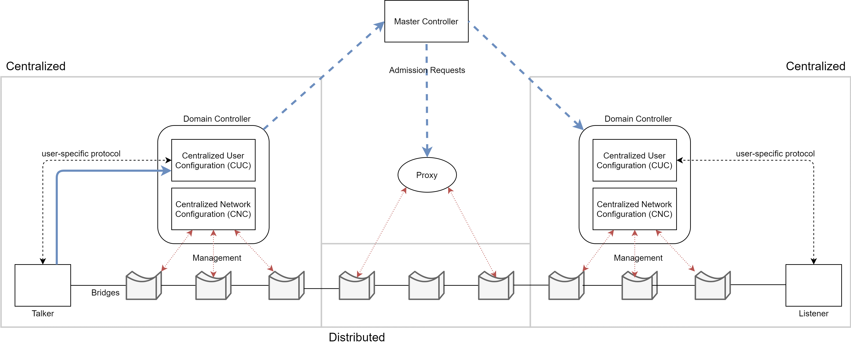
TEXT BELOW IMAGE
HEADING
TEXT

